Slide 1
Open Innovation – Climate Change
BlueberryCider

Slide 2
How Poverty and Trade Impact Carbon Footprint
This presentation will explore the impact of poverty and trade on carbon footprint
Impact of Poverty on Carbon Footprint
Poverty can contribute to higher carbon footprints due to lack of access to clean energy and inefficient use of resources.
Impact of Trade on Carbon Footprint
Trade can lead to increased carbon footprints due to transportation and production processes.

Slide 3
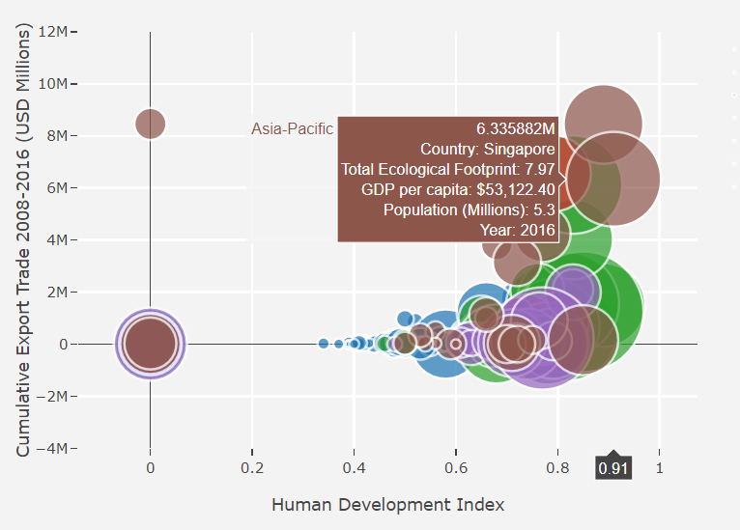
Analysis
Visualizing the relationship between Human Development Index (HDI), Cumulative Export Trade, and Carbon Footprint for different regions where each color represents a country .

Slide 4
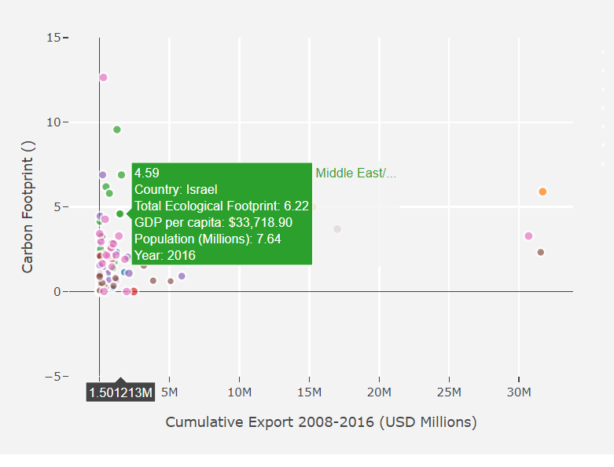
More a country trades, the more carbon footprint
Bubble chart that visualizes the relationship between Cumulative Export Trade and Carbon Footprint for different regions.

Slide 5
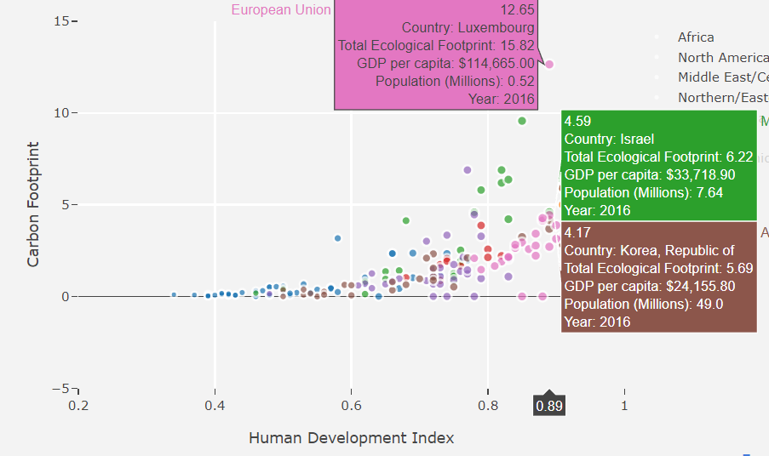
More Poverty a country has, the more carbon footprint

Slide 6
CO2 EMISSION IN SECTORS
CO2 emissions, primarily from the energy sector, transportation, and industry, are a major driver of global climate change. These emissions result from burning fossil fuels, industrial processes, and land-use changes. Mitigating CO2 emissions is crucial to combatting climate change, with efforts focused on renewable energy adoption, efficiency improvements, and sustainable practices.
Now that we have seen the relationship between the carbon footprint and that of poverty and trade. We will now measure the carbon footprint of every sector, that being Industry, Ground Transport , Domestic Aviation , International Aviation and etc for every major country that contributes to the emission.

Slide 7
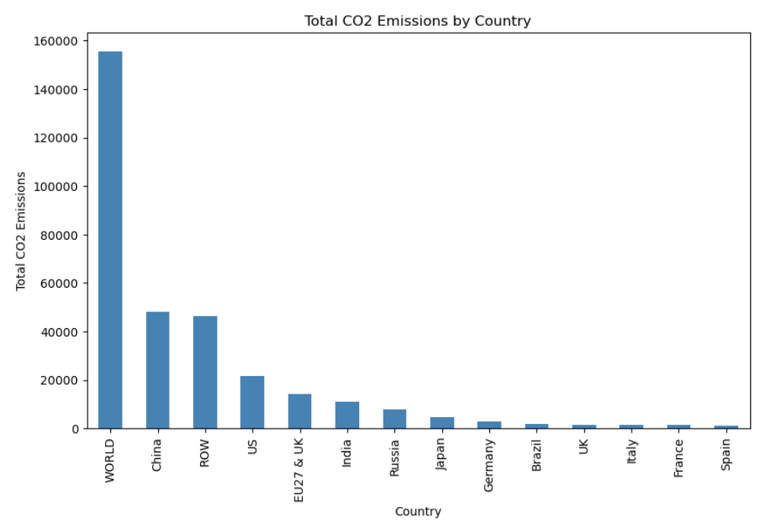
Analysis

Slide 8
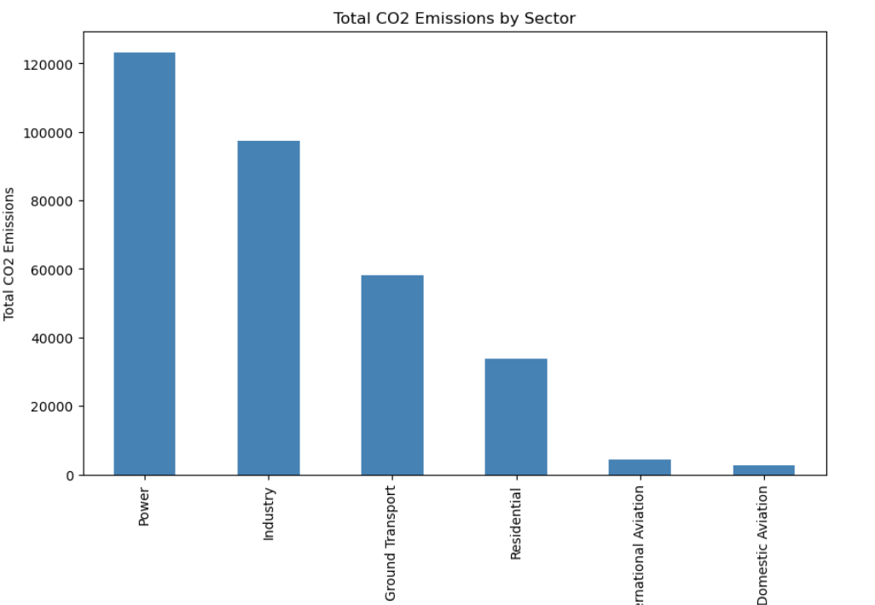
Total emission by sectors

Slide 9
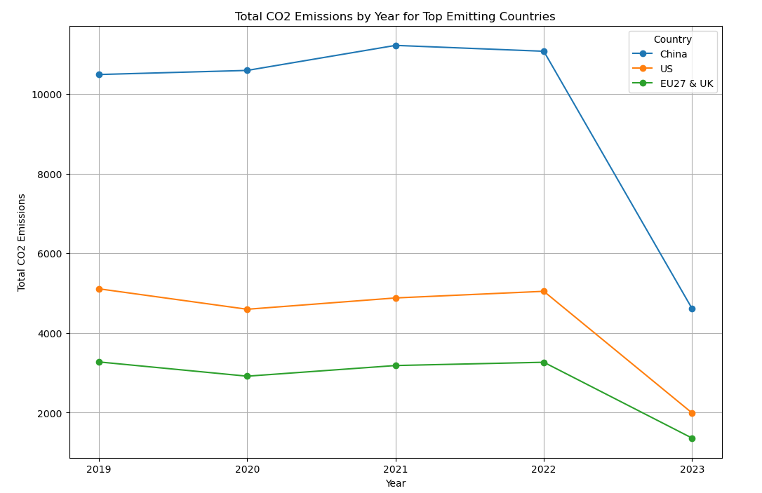
By year and sector for top emitting countries

Slide 10
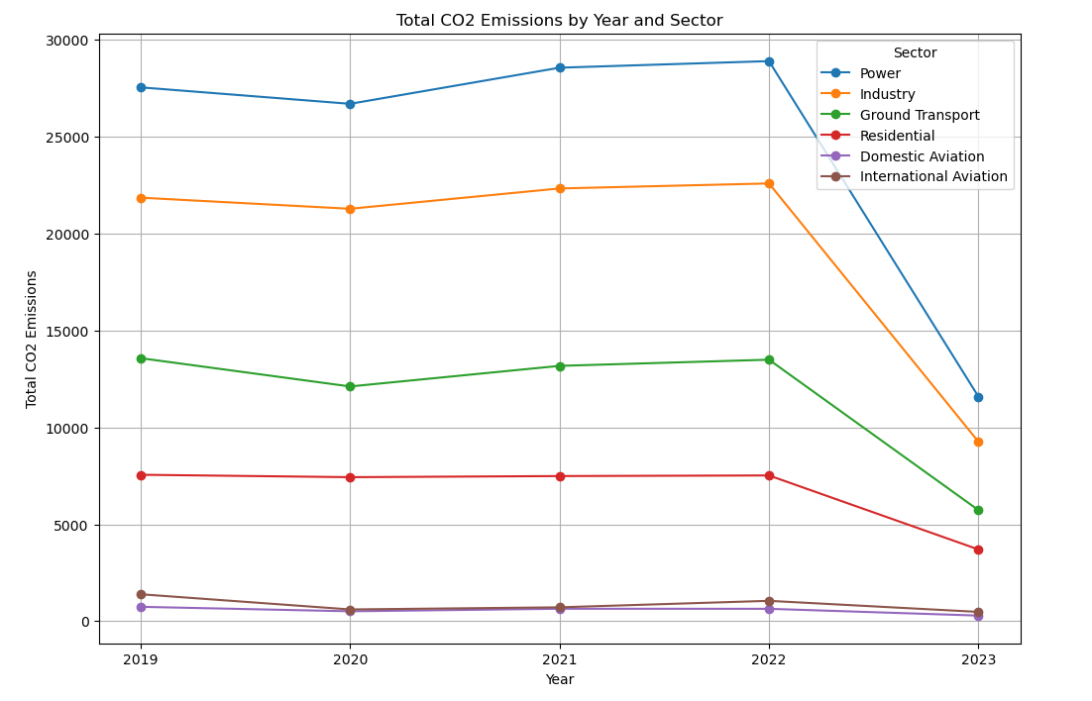
By year and sector
The same analysis is also done for each top emitting country that being CHINA,US and UK

Slide 11
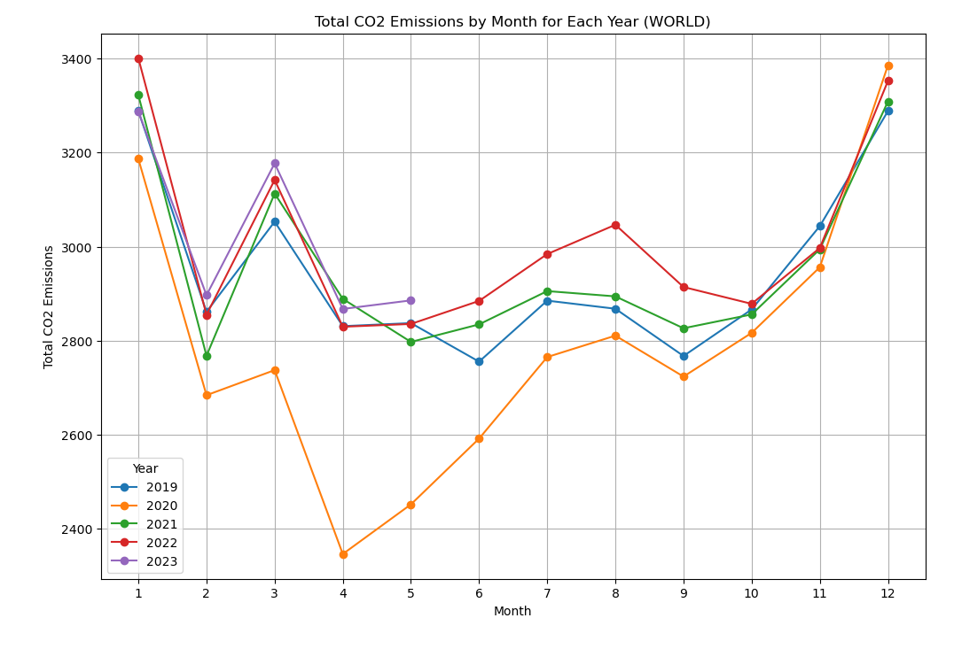
By Month for each year
The same analysis is also done for each top emitting
country

Slide 12
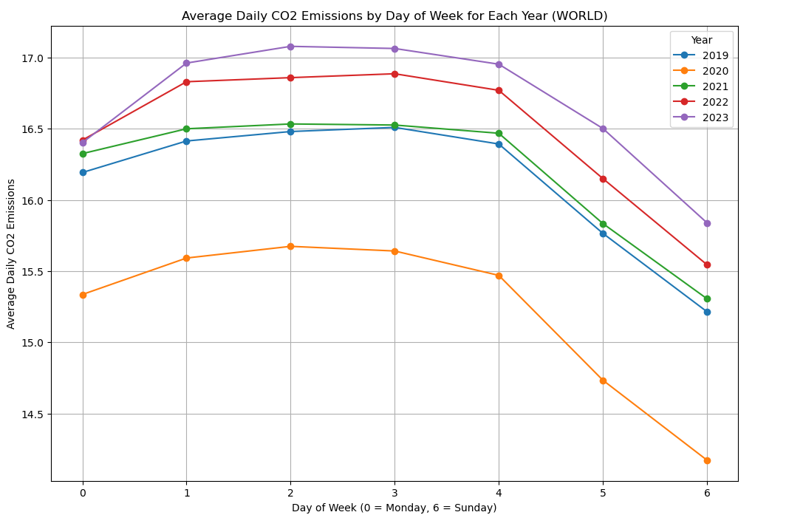
By day of the week
CO2 emissions vary significantly across sectors, with energy production, transportation, and industry being the major contributors, in terms of countries the major contributors are china,us and uk. Addressing emissions requires a multi-faceted approach, including transitioning to clean energy sources, enhancing energy efficiency, and promoting sustainable practices in agriculture and land use. Effective mitigation efforts in these sectors are vital to combat climate change and achieve a more sustainable future.

Slide 13
Analysis of the impact of esg funds
In the financial fund industry, does green investment generate better performance ?
* The idea of this project came from the raising interest in ESG funds to provide more sustainable investment vehicles to financial investors.
* The aim of this project is to analyze if funds selecting underlying environmental friendly assets can generate better financial performance.
* Finding available market data about ESG was a difficult task, as this kind of data is most of the time issued by market/index providers (MSCI, FTSE) and not freely available to the public. Hopefully, the platform https://fossilfreefunds.org/ offers more than 3,000 US stock funds ratings about environmental metrics with more than 10 months history.

Slide 14
* The outcome of this project is to predict performance of a fund based on ESG features
* The target is the *Financial performance: Month end trailing returns, year 1* variable
* This is a regression problem
* The principal ML training algorithm that will be used is the *Ridge regression* with :
* Splitting for test and training data set
* Standardization of data based on training set
* Grid search for finding the best regularization (alpha parameter)
* The features will be select among through SelectKBest method (f_regression, mutual_info_regression)

Slide 15
* Models will range from
* simple model: 3 features
* intermediate model: 10 features to 20 features
* complex model: all features
* We will also experiment using other ML training regressors such as *RandomForests, kNNs and neural networks* to allow comparison with results from *Ridge regression*
* The pre-processing part will mainly required that we have no null values in our dataset
* Ridge regression with optimization of the regularization parameter will be used
* Our baseline will be the *median* of performance price return
* For assessing the accuracy of our model (cost function), we will use the MAE (Mean Absolute Error) method:
* MAE is easy to interpret. For instance, a score of 3 means that the predictions are, in average, above or below the observed value by a distance of 3.
* The MAE method is robust to outliers which is a nice statistical property but is difficult to optimize because it's not smooth.

